Slide 1


Slide 2
Benefits
High Performance
App based data structures
High Availability
automatic failover.
data redundancy
Automatic Scaling
Automatic sharding

Slide 3
NoSQL database
Drivers exist for different languages
C/C++/C#
Java
JavaScript
Node.js
Perl
PHP
Python
Ruby
Etc.

Slide 4
Quirks
No JOINs
Must do join in application or keep all data together
No FKs
Calls are atomic but not transactional.
A second call will not interrupt an individual read/write but could interrupt a mass read/write op

Slide 5
JSON Document Store
{ “_id”: ObjectId(“1234”),
“number”: 5,
“string”: “test”,
“object”: {
“blob”: binary_data,
“bool”: true
},
“array”: [1,2,3,4],
“dates”: new Date('Jun 23, 1912'),
“null”: null,
“Reg Ex”: /^abc/,
“JS”: function test() { return “there are more”;}
}

Slide 6
CRUD
Create -> insert(), save()
Read -> find()
Update -> update(), save()
Delete -> remove()

Slide 7
Finding Data
.find(<query>, <projection>)
db.zips.find({“state”: “CA”, _id: {$gt:{_id:11111}}})
db.zips.findOne({“city”: “NEW YORK”, “state”:”NY”}, {state:1, _id:0})

Slide 8
Aggregation Pipeline
$match -> WHERE/HAVING
$sort -> ORDER BY
$limit -> LIMIT
$skip
$project -> SELECT
$unwind -> JOIN?
$group -> GROUP BY
$sum -> SUM() / COUNT()

Slide 9
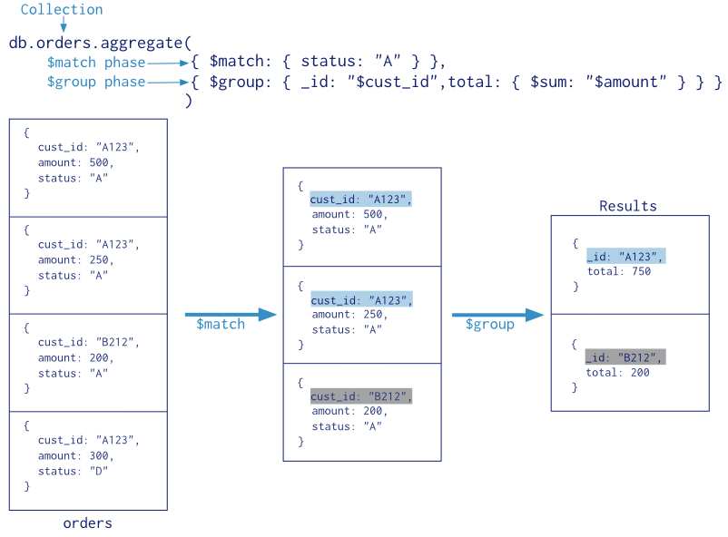
Aggregation Pipeline

Slide 10
Links
http://www.mongodb.org/
https://education.mongodb.com/

